Slide 1
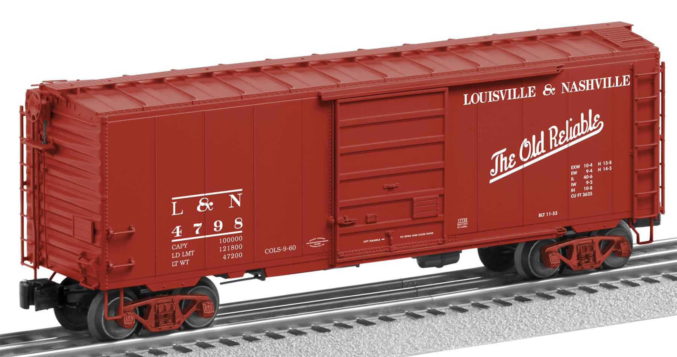
“Boxcar” systems
Distributed computing for pennies

Slide 2
Agenda
Sources of cost
Introduction to “event sourcing”
Introduction to Azure Event Grid / Azure storage
Overview of a proposed system
Lessons learned

Slide 3


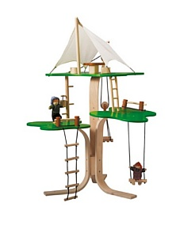
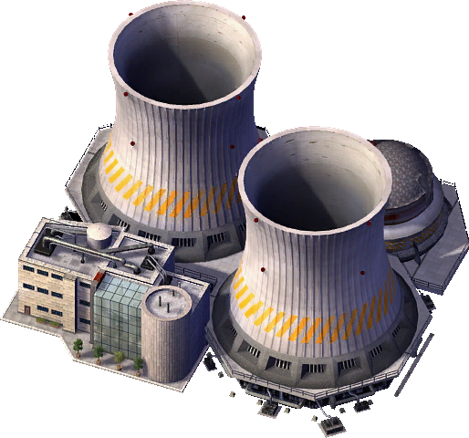


Caveats

Slide 4
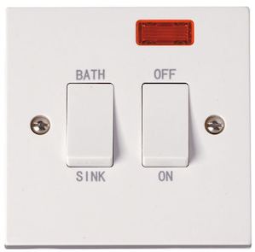
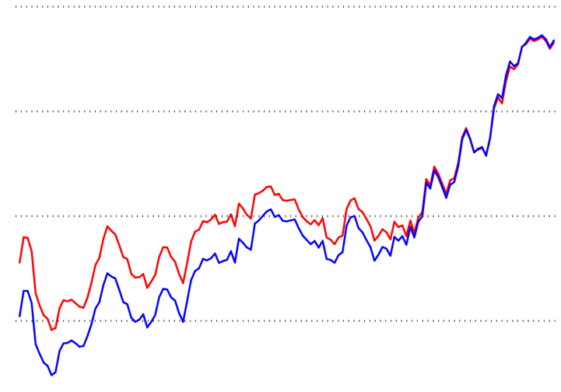
Sources of cost
Fixed costs
Overprovisioning

Slide 5

Introduction to “event sourcing”

Slide 6
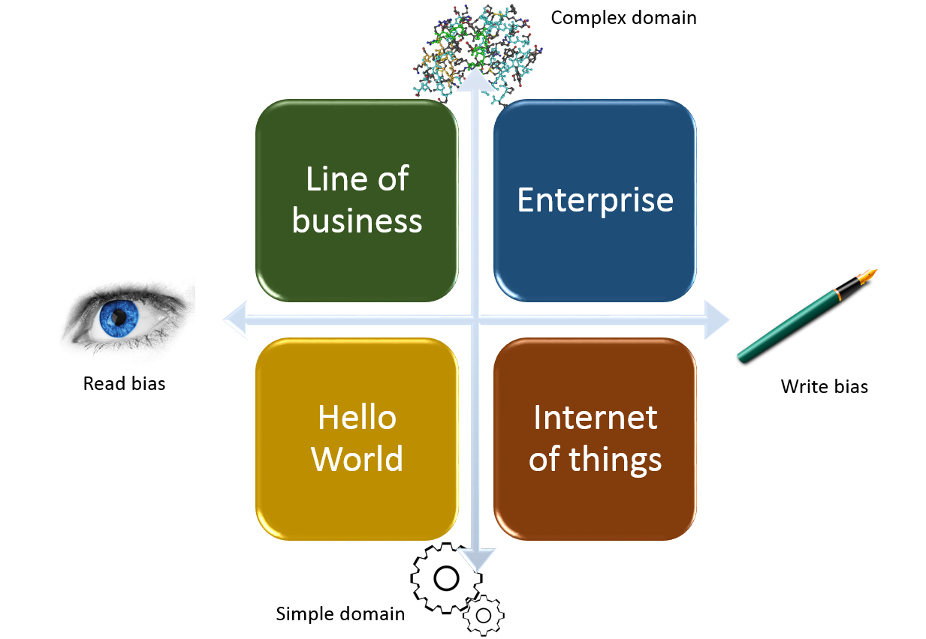
Introduction to Azure Storage
Cosmos Db
Tables
Files
Append Blob

Slide 7
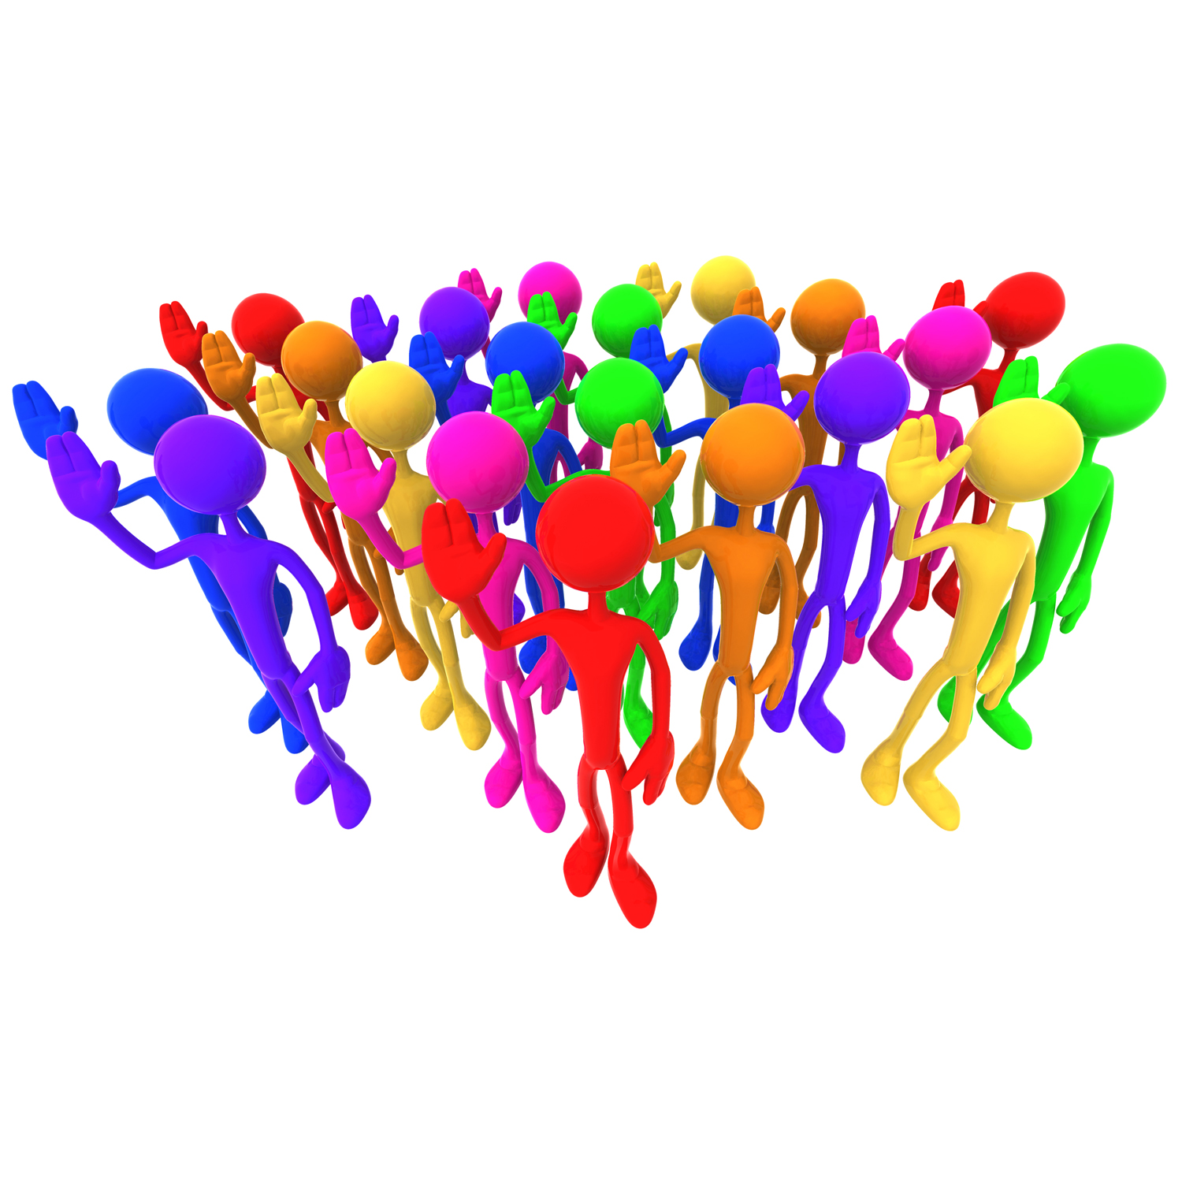


Overview of a proposed system
League
Race
Runner

Slide 8



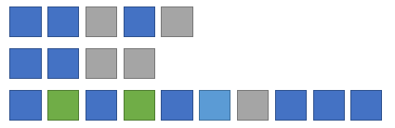
Handling a command
Durable Function Orchestration
Append
Event(s)
Command
Validations

Slide 9
Handling a query
Durable Function Orchestration
Query
Validations
Run
Projection
Return
Results

Slide 10
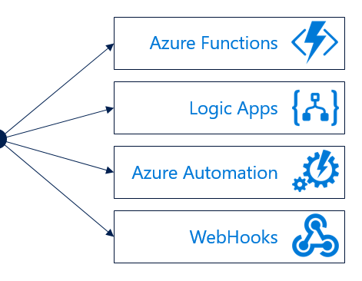
Notifications and inter-domain communication

Slide 11
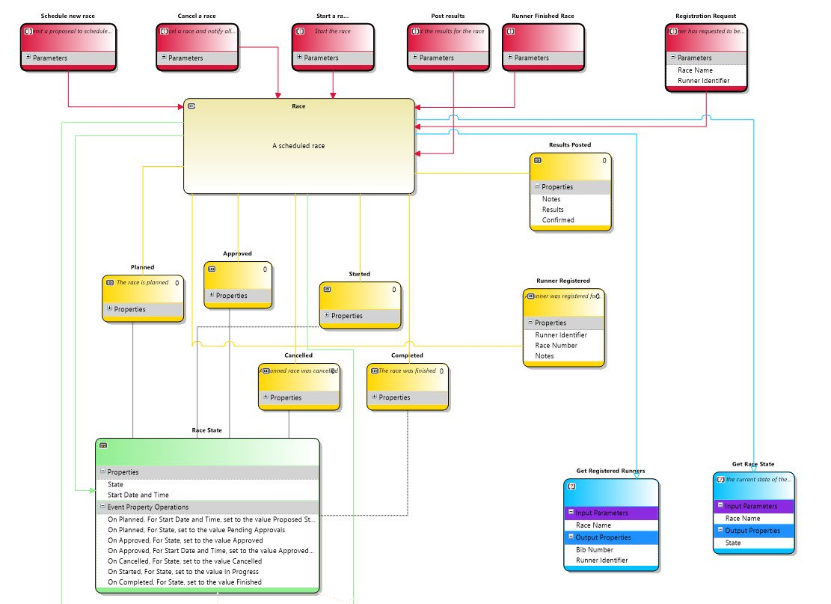
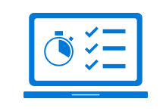
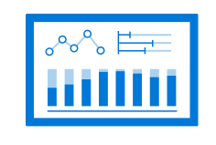
Lessons learned
Don’t assume. Measure!
Invest time in design
Read your writes

Slide 12
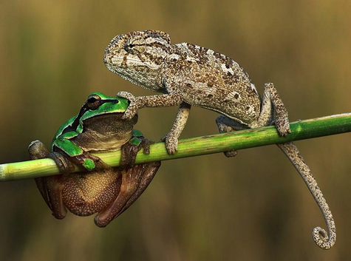
Questions?
@Merrion

